Slide 1
17/03/2022
Title: Expanding brackets
Aim:
Be able to use the DPM/A to expand bracketed terms.
Plan:
Daily review:
DPM/A
Directed number.
Multiply rules.
Simplify DPM/A expressions with multiple brackets.

Slide 2
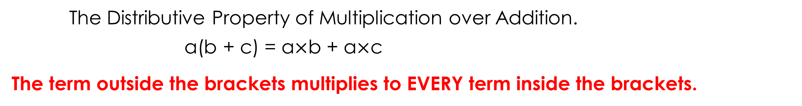
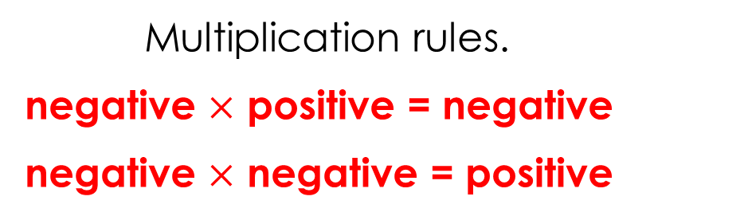
The Distributive Property of Multiplication over Addition.
a(b + c) = a$×$b + a$×$c
The term outside the brackets multiplies to EVERY term inside the brackets.
Simplifying double signs
Same signs add, different signs subtract.
a – (-b) a + (-b)
= a + b = a – b
Multiplication rules.
negative $×$ positive = negative
negative $×$ negative = positive
Notes:
Student notes

Slide 3
The Distributive Property of Multiplication over Addition.
a(b + c) = a$×$b + a$×$c
The term outside the brackets multiplies to EVERY term inside the brackets.
Simplifying double signs
Same signs add, different signs subtract.
a – (-b) a + (-b)
= a + b = a – b
Multiplication rules.
negative $×$ positive = negative
negative $×$ negative = positive

Slide 4
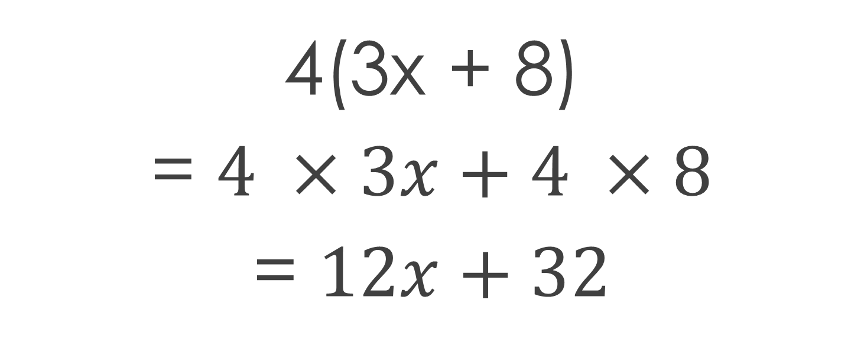
Outside term
Terms inside the brackets
4(3x + 8)
= $4 ×3x+4 ×8$
= $12x+32$
Notes:
Student notes

Slide 5
Outside term
Terms inside the brackets
4(3x + 8)
= $4 ×3x+4 ×8$
= $12x+32$

Slide 6
I do
3(2x + 4)
5(4f – 5)
4(d + 6) + 2(2d + 3)

Slide 7
Whiteboards
4(3x + 1)
2(5f – 7)
3(6 – 4e)
3(3d – 5)

Slide 8
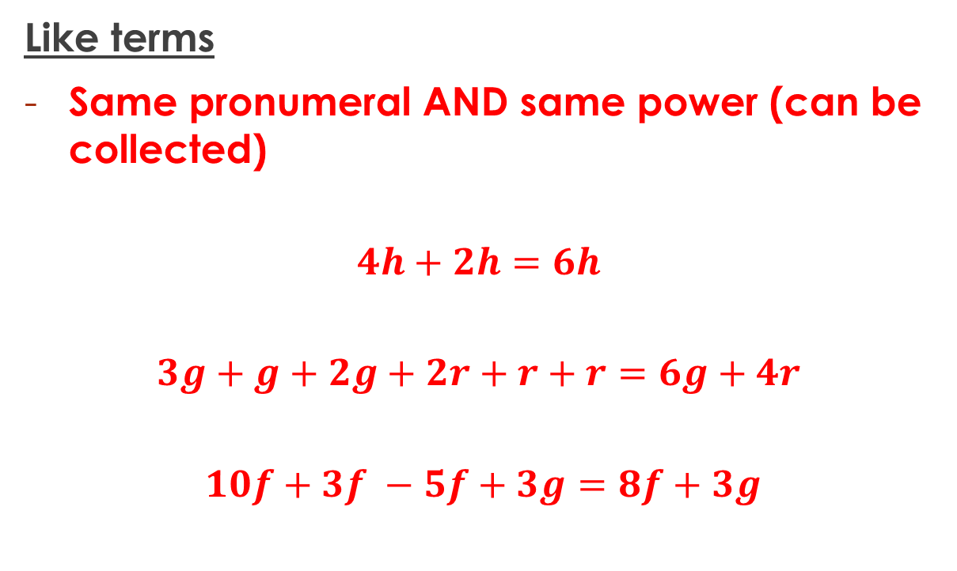
Terminology
Like terms
Same pronumeral AND same power (can be collected)
$$4h+2h=6h$$
$$3g+g+2g+2r+r+r=6g+4r$$
$$10f+3f −5f+3g=8f+3g$$

Slide 9
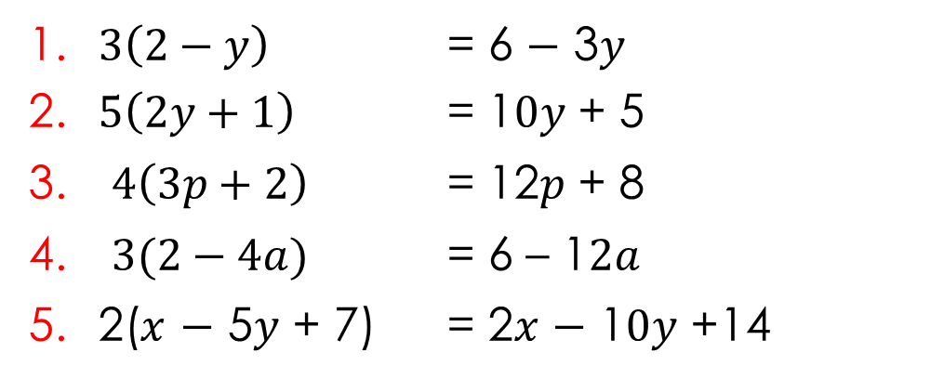
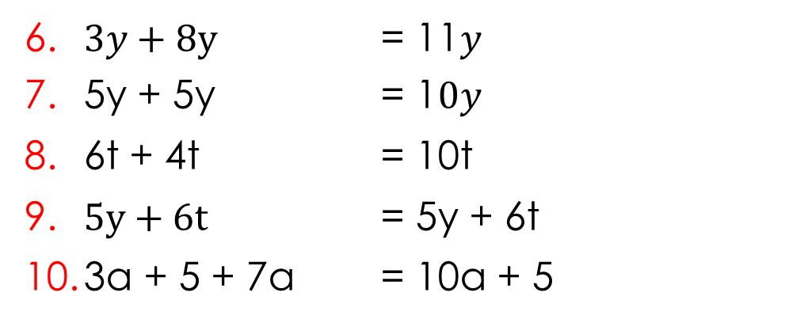
Simplify each of the following
1. $3\left(2−y\right)$ = 6 $−$ 3$y$
2. $5\left(2y+1\right)$ = 1$0y$ + 5
$4\left(3p+2\right)$ = 12$p$ + 8
$3(2−4a)$ = 6 – 1$2a$
5. 2($x$ $−$ 5$y$ + 7) = 2$x$ $−$ 1$0y$ +14
6. $3y+$ 8y = 11$y$
7. 5y + 5y = 1$0y$
8. 6t + 4t = 10t
9. $5y+6t$ = 5y + 6t
10. 3a + 5 + 7a = 10a + 5
Notes:
Student worksheet

Slide 10
Exercise books
DPM/A with multiple brackets
2(3 + 2y) + 2(4 + y)
4(m + 4p) + 3(2m + p)
3(a + 2b) + 5(4a + 3b)
2(p + 3q) + 3(2p + q) + 2(2p + 3q)

Slide 11
Practise
Practise
Practise

Slide 12
Challenge Questions:
$$2(3 + 2x) – 3(3x + 2) + 4(2 – 5x) – 2x$$
$$−2\left(3 +3x\right) – 3\left(2 − 3x\right)+ 4\left(2 – 5x\right)+(–2x)$$

Slide 13
Reflection – fist to 5
Aim:
Be able to use the DPM/A to expand bracketed terms.

